Slide 1



PROGRESS REPORT
DISTRICT –
REGION
, 2023

Slide 2
District Overview
Taluka | Category | No. of Schemes |  | Work Order Issued |  | Work In Progress |  | Work Not Started
 |  | PMC | TSP | PMC | TSP | PMC | TSP | PMC | TSP
Bhoom | Retro | 27 | 28 | 27 | 27 | 16 | 13 | 11 | 14
 | New | 8 | 9 | 8 | 9 | 4 | 4 | 4 | 5
Kalamb | Retro | 20 | 19 | 20 | 18 | 10 | 12 | 10 | 6
 | New | 8 | 7 | 8 | 7 | 5 | 4 | 3 | 3
Lohara | Retro | 13 | 0 | 13 | 0 | 5 | 0 | 8 | 0
 | New | 2 | 0 | 2 | 0 | 1 | 0 | 1 | 0
Omerga | Retro | 39 | 2 | 39 | 2 | 18 | 0 | 21 | 2
 | New | 11 | 4 | 11 | 4 | 5 | 0 | 6 | 4
Osmanabad | Retro | 20 | 32 | 20 | 29 | 4 | 19 | 16 | 10
 | New | 14 | 18 | 14 | 17 | 7 | 11 | 7 | 6
Paranda | Retro | 34 | 17 | 34 | 17 | 23 | 8 | 11 | 9
 | New | 16 | 3 | 16 | 3 | 10 | 2 | 6 | 1
Tuljapur | Retro | 37 | 31 | 37 | 31 | 19 | 18 | 18 | 13
 | New | 0 | 4 | 0 | 4 | 0 | 4 | 0 | 0

Slide 3
District Overview
Taluka | Category | No. of Schemes |  | Work Order Issued |  | Work In Progress |  | Work Not Started
 |  | PMC | TSP | PMC | TSP | PMC | TSP | PMC | TSP
Washi | Retro | 25 | 3 | 25 | 3 | 15 | 0 | 10 | 3
 | New | 6 | 1 | 6 | 1 | 4 | 0 | 2 | 1
Total | Retro | 215 | 132 | 215 | 127 | 110 | 70 | 105 | 57
 | New | 65 | 46 | 65 | 45 | 36 | 25 | 29 | 20
Grand Total |  | 280 | 178 | 280 | 172 | 146 | 95 | 134 | 77
 |  | 458 |  | 452 |  | 241 |  | 211

Slide 4
Executive Summary Work in Progress Schemes
Taluka | Category | No. of Schemes | No. of Schemes based on Physical Progress %
 |  |  | < 25% | 25 < 50% | 50 < 75% | 75 < 100% | Commissioned
Bhoom | Retro | 29 | 25 | 3 | 1 | 0 | 0
 | New | 8 | 8 | 0 | 0 | 0 | 0
Kalamb | Retro | 22 | 14 | 2 | 5 | 1 | 0
 | New | 9 | 5 | 3 | 1 | 0 | 0
Lohara | Retro | 5 | 1 | 4 | 0 | 0 | 0
 | New | 1 | 1 | 0 | 0 | 0 | 0
Omerga | Retro | 18 | 16 | 2 | 0 | 0 | 0
 | New | 5 | 4 | 1 | 0 | 0 | 0
Osmanabad | Retro | 23 | 10 | 7 | 4 | 2 | 0
 | New | 18 | 10 | 7 | 0 | 1 | 0
Paranda | Retro | 31 | 23 | 6 | 1 | 1 | 0
 | New | 12 | 9 | 1 | 1 | 1 | 0
Tuljapur | Retro | 37 | 23 | 10 | 3 | 1 | 0
 | New | 4 | 2 | 2 | 0 | 0 | 0

Slide 5
Executive Summary Work in Progress Schemes
Taluka | Category | No. of Schemes | No. of Schemes based on Physical Progress %
 |  |  | < 25% | 25 < 50% | 50 < 75% | 75 < 100% | Commissioned
Washi | Retro | 15 | 11 | 4 | 0 | 0 | 0
 | New | 4 | 1 | 2 | 1 | 0 | 0
Total | Retro | 180 | 123 | 38 | 14 | 5 | 0
 | New | 61 | 40 | 16 | 3 | 2 | 0
Grand Total |  | 241 | 163 | 54 | 17 | 7 | 0

Slide 6
Abstract of Schemes – Work in Progress Category – “Retro”
Sr No | Scheme Name | Name of Agency | W.O. Amount (excl GST) | W.O. Date | Construction Period | Physical Progress | RA Bill (Recommended) % | RA Bill (Recommended) In Lakhs
Bhoom Taluka | Bhoom Taluka
1 | Bhavanwadi(Sukta) | Sandipan Shahuraj Gund | 13,73,869 | 06-10-2022 | 18 Months | 56.08% | - | -
2 | Anjansonda | Shubham Kisan Jadhav | 21,59,028 | 06-10-2022 | 18 Months | 42.90% | - | -
3 | Hivarda | Shubham Kisan Jadhav | 14,42,802 | 06-10-2022 | 18 Months | 38.03% | - | -
4 | Ambi | R N Kokate Construction Company | 49,69,389 | 23-06-2022 | 18 Months | 26.31% | - | -
5 | Pathrud | Vanve Abadev Baburao | 41,80,713 | 29-06-2022 | 18 Months | 21.19% | - | -
6 | Devangra | Abadev Baburao Vanve | 63,70,670 | 18-10-2022 | 15 Months | 17.94% | - | -
7 | Gormala | Vikram Sampat Khanvilkar | 10,21,454 | 26-07-2022 | 18 Months | 14.72% | - | -
8 | Bavi | Ghodake Namdev Murlidhar | 71,24,055 | 03-11-2022 | 15 Months | 14.44% | - | -
9 | Burundwadi | Vikram Sampat Khanvilkar | 21,24,020 | 30-01-2023 | 15 Months | 13.11% | - | -
10 | Lanjeshwar | Ms S V Bhoite | 79,92,150 | 28-10-2022 | 15 Months | 2.27% | - | -
11 | Ulup | Ms. R.D. Construction | 73,22,771 | 21-10-2022 | 15 Months | 1.46% | - | -
12 | Ashta | Rajkumar Shrimant Ghrat | 93,89,128 | 14-10-2022 | 15 Months | 0.93% | - | -
13 | Bhongiri | Sayyad Naushad Shabbir | 31,04,283 | 03-11-2022 | 15 Months | 0.80% | - | -

Slide 7
Abstract of Schemes – Work in Progress Category – “Retro”
Sr No | Scheme Name | Name of Agency | W.O. Amount (excl GST) | W.O. Date | Construction Period | Physical Progress | RA Bill (Recommended) % | RA Bill (Recommended) In Lakhs
14 | Nagewadi | Vaishnavi Balaji Gawli | 33,70,930 | 23-09-2022 | 15 Months | 0.75% | - | -
15 | Bahranpur | Ch. Dnyaneshwar Mauli M S S | 21,21,728 | 10-06-2022 | 18 Months | 0.73% | - | -
16 | Ralesangavi | Vanve Abadev Baburao | 66,93,197 | 14-10-2022 | 15 Months | 0.61% | - | -
17 | Wadachi Wadi | B.B. Lahamge | 41,05,719 | 10-03-2022 | 15 Months | 0.59% | - | -
18 | Wakwad | Ms S A Group Developers | 73,45,063 | 01-11-2023 | 15 Months | 0.44% | - | -
19 | Sadesaangvi | R.N. Kokate Construction | 47,23,888 | 14-10-2022 | 15 Months | 0.40% | - | -
20 | Nannajwadi | Daivshala Datta Sathe | 25,25,422 | 18-01-2023 | 15 Months | 0.32% | - | -
21 | Andrud | Ms Aditya Construction | 1,15,38,061 | 25-01-2023 | 15 Months | 0.26% | - | -
22 | Nipani | R.N. Kokate Construction | 50,46,589 | 11-07-2022 | 15 Months | 0.21% | - | -
23 | Umachiwadi | Aniket Sadashiv Nagargoje | 27,75,750 | 25-01-2023 | 15 Months | 0.21% | - | -
24 | Jelja | Ms Sayeem Construction | 63,94,312 | 28-10-2022 | 15 Months | 0.20% | - | -
25 | Anandwadi | Abadev Baburao Vanve | 84,50,912 | 18-01-2023 | 15 Months | 0.14% | - | -
26 | Ganegaon | Ms Soham Construction | 98,08,724 | 01-05-2023 | 15 Months | 0.14% | - | -
27 | Wangi (Bk) | Gopal Construction | 56,25,367 | 10-06-2022 | 15 Months | 0.13% | - | -

Slide 8
Abstract of Schemes – Work in Progress Category – “Retro”
Sr No | Scheme Name | Name of Agency | W.O. Amount (excl GST) | W.O. Date | Construction Period | Physical Progress | RA Bill (Recommended) % | RA Bill (Recommended) In Lakhs
28 | Malewadi | R.N. Kokate Construction | 43,44,388 | 14-10-2022 | 15 Months | 0.11% | - | -
29 | Giralgaon | Abadev Baburao Vanve | 64,46,695 | 31-10-2022 | 15 Months | 0.07% | - | -
Kalamb Taluka | Kalamb Taluka
30 | Kherda | Ms Jaibhavni Construction | 55,77,213 | 28-10-2022 | 15 Months | 90.10% | - | -
31 | Hasegaon(Shirdhon) | Aditya Construction | 33,26,826 | 10-12-2022 | 15 Months | 61.08% | 48.97% | 16.29
32 | Bangarwadi | Ms D.S.L. Infra | 63,72,482 | 29-12-2022 | 15 Months | 60.74% | - | -
33 | Wathwada | Bharat Laxman Ingale | 53,27,367 | 19-08-2022 | 18 Months | 60.70% | 58.41% | 31.12
34 | Uplai | Aditya Construction | 76,89,983 | 06-10-2022 | 18 Months | 57.04% | 56.84% | 43.71
35 | Deolali | Aditya Construction | 68,83,117 | 27-09-2022 | 15 Months | 53.20% | - | -
36 | Bhosa | Syed Rashid Sartaj | 16,28,252 | 06-03-2022 | 18 Months | 29.97% | - | -
37 | Haldgaon | Kazi Soheluddin Sadik Hussain | 19,69,588 | 06-10-2022 | 15 Months | 29.16% | - | -
38 | Yerangaon | Syed Rashid Sartaj | 13,73,788 | 06-03-2022 | 18 Months | 18.79% | - | -
39 | Bhat Sangvi | Che. Mesaai M.S.S.S | 11,80,029 | 01-05-2023 | 15 Months | 18.54% | - | -
40 | Bhogaji | Om Construction | 39,13,744 | 29-06-2022 | 18 Months | 18.45% | - | -

Slide 9
Abstract of Schemes – Work in Progress Category – “Retro”
Sr No | Scheme Name | Name of Agency | W.O. Amount (excl GST) | W.O. Date | Construction Period | Physical Progress | RA Bill (Recommended) % | RA Bill (Recommended) In Lakhs
41 | Wagholi | Aditya Construction | 48,57,457 | 06-03-2022 | 18 Months | 13.48% | - | -
42 | Bhat Shirapura | Ganesh Samb Vharkat | 63,41,114 | 01-11-2023 | 15 Months | 11.27% | - | -
43 | Ratnapur | Ganesh Samb Vharkat | 59,73,639 | 01-11-2023 | 15 Months | 9.54% | - | -
44 | Athardi | Ms Dattaprasad Construction | 40,13,834 | 22-10-2022 | 15 Months | 8.41% | - | -
45 | Babhalgaon | Sujata Construction | 70,63,443 | 01-11-2023 | 15 Months | 7.99% | - | -
46 | Wadgaon Shirdhon | Pravin Anandrao Gadle | 81,09,045 | 27-12-2022 | 15 Months | 7.85% | - | -
47 | Nipani | Ch. Sanvi M S S | 15,41,307 | 06-03-2022 | 18 Months | 5.64% | - | -
48 | Hasegaon (Kej) | M.D.S.L.Infra.Devlopers. | 99,59,783 | 14-10-2022 | 15 Months | 3.67% | - | -
49 | Khondala | Vaishnavi Balaji Gawli | 79,12,152 | 28-10-2022 | 15 Months | 1.73% | - | -
50 | Khadaki | Ganesh Samb Vharkat | 61,60,596 | 25-01-2023 | 15 Months | 0.57% | - | -
51 | Massa (Kh) | Vaishnavi Balaji Gawli | 1,22,80,701 | 20-09-2022 | 15 Months | 0.20% | - | -
Lohara Taluka | Lohara Taluka
52 | Achaler | Ganesh Engineers And Associates | 1,47,06,061 | 01-12-2023 | 15 Months | 43.26% | - | -
53 | Wadiwadgaon | Suraj Rajendra Devkar | 23,81,363 | 10-06-2022 | 15 Months | 31.60% | 29.84% | 7.11

Slide 10
Abstract of Schemes – Work in Progress Category – “Retro”
Sr No | Scheme Name | Name of Agency | W.O. Amount (excl GST) | W.O. Date | Construction Period | Physical Progress | RA Bill (Recommended) % | RA Bill (Recommended) In Lakhs
54 | Khed | R.D. Construction | 1,59,18,270 | 27-09-2022 | 15 Months | 30.48% | - | -
55 | Bhatangali | Ganesh Engineers And Associates | 1,36,41,940 | 01-12-2023 | 15 Months | 25.22% | 19.64% | 26.79
56 | Toramba | Raghunath Shrinivas Shinde | 47,13,121 | 19-10-2022 | 15 Months | 0.02% | - | -
Omerga Taluka | Omerga Taluka
57 | Koral | Amardeep Construction | 1,11,17,851 | 28-10-2022 | 15 Months | 28.93% | - | -
58 | Kothali | Krushnai Construction | 1,33,37,832 | 21-10-2022 | 15 Months | 27.27% | 26.15% | 34.88
59 | Ekurgawadi | Ganesh Samb Vharkat | 39,26,051 | 29-12-2022 | 15 Months | 22.25% | 15.72% | 6.17
60 | Malikwadi | Ms Patel Construction | 64,53,609 | 31-10-2022 | 15 Months | 20.93% | - | -
61 | Chinchkota | Darshana Shivaji Chavan | 54,10,809 | 19-01-2023 | 15 Months | 19.98% | 16.20% | 8.77
62 | Dabka | Alim Abdul Vijapure | 87,79,195 | 31-10-2022 | 15 Months | 19.68% | - | -
63 | Kadmapur | Pravin Mohanrao Kamble | 43,89,735 | 29-12-2022 | 15 Months | 19.13% | - | -
64 | Dudhanal | Ch. Hanuman M S S | 21,61,813 | 21-11-2022 | 15 Months | 18.58% | - | -
65 | Kanhali | Ms Patel Construction | 91,88,941 | 31-10-2022 | 15 Months | 18.23% | - | -
66 | Wagdari | Pruthviraj Shivaji Chavan | 93,14,836 | 18-01-2023 | 15 Months | 17.90% | 16.47% | 15.34

Slide 11
Abstract of Schemes – Work in Progress Category – “Retro”
Sr No | Scheme Name | Name of Agency | W.O. Amount (excl GST) | W.O. Date | Construction Period | Physical Progress | RA Bill (Recommended) % | RA Bill (Recommended) In Lakhs
67 | Mahalingraiwadi | Pruthviraj Shivaji Chavan | 68,86,926 | 29-12-2022 | 15 Months | 14.26% | 12.70% | 8.75
68 | Murali | Amardeep Construction | 82,20,403 | 28-10-2022 | 15 Months | 12.63% | - | -
69 | Chandkal | Alim Abdul Vijapure | 37,70,369 | 27-01-2023 | 15 Months | 10.98% | - | -
70 | Malagiwadi | Alim Abdul Vijapure | 51,50,724 | 21-10-2022 | 15 Months | 10.72% | - | -
71 | Dhanora Dagad | Alim Abdul Vijapure | 96,29,179 | 31-10-2022 | 15 Months | 10.64% | - | -
72 | Kesar Jawalga | Krushnai Construction | 1,70,90,550 | 21-10-2022 | 15 Months | 10.43% | - | -
73 | Kantekur | Ganesh Engineers And Associates | 78,65,585 | 11-03-2022 | 15 Months | 9.51% | - | -
74 | Bhikar Sangvi | Krushnai Construction | 1,07,70,094 | 28-10-2022 | 15 Months | 2.53% | - | -
Osmanabad Taluka | Osmanabad Taluka
75 | Vittalwadi | Khatake Shankar Shesherao | 8,80,114 | 27-07-2022 | 6 Months | 98.55% | - | -
76 | Gaudgaon | Vaishnavi Balaji Gawli | 20,36,692 | 03-06-2022 | 18 Months | 95.76% | 46.25% | 9.42
77 | Mhadewadi | Sarpach/Gramsewak | 5,49,310 | 31-03-2022 | 3 Months | 66.20% | 65.22% | 3.58
78 | Khamaswadi | Ch. Krishna Majur Sahkari Sanstha | 17,39,375 | 06-03-2022 | 18 Months | 57.54% | 36.53% | 6.35
79 | Mulewadi | Swapnil Navnath Naikwadi | 21,21,640 | 06-03-2022 | 18 Months | 53.46% | 46.48% | 9.86

Slide 12
Abstract of Schemes – Work in Progress Category – “Retro”
Sr No | Scheme Name | Name of Agency | W.O. Amount (excl GST) | W.O. Date | Construction Period | Physical Progress | RA Bill (Recommended) % | RA Bill (Recommended) In Lakhs
80 | Bhandari | Ms. S A Group Developers | 19,91,008 | 29-06-2022 | 18 Months | 52.18% | - | -
81 | Toramba | Pawan Prakash Swami | 21,16,826 | 23-06-2022 | 18 Months | 46.17% | - | -
82 | Uttami Kayapur | Ch. Krishna Majur Sahkari Sanstha | 17,14,119 | 06-03-2022 | 18 Months | 44.57% | 42.71% | 7.32
83 | Gogaon | Khatake Shankar Shesherao | 8,43,826 | 23-08-2022 | 15 Months | 40.13% | - | -
84 | Ansurda | Ch. Kashtkari M S S | 20,80,646 | 05-03-2022 | 18 Months | 32.62% | - | -
85 | Dakwadi | Ms. S A Group Developers | 12,38,070 | 25-07-2022 | 18 Months | 29.15% | - | -
86 | Takali (B) | Ganesh Samb Vharkat | 44,83,922 | 09-07-2022 | 12 Months | 27.80% | - | -
87 | Walgud | Vinayak Vishwanath Khadke | 21,13,651 | 06-10-2022 | 18 Months | 25.91% | - | -
88 | Pohner | Prashant Prabhakar Mule | 20,50,660 | 08-05-2022 | 18 Months | 17.52% | - | -
89 | Kond | Ch Sangvi M S S | 19,91,075 | 06-03-2022 | 18 Months | 16.17% | - | -
90 | Gopalwadi | Swapnil Navnath Naikwadi | 21,59,692 | 18-06-2022 | 18 Months | 7.58% | - | -
91 | Bamni | Ch. Kashtkari M S S | 21,53,559 | 06-03-2022 | 18 Months | 5.63% | - | -
92 | Bavi | Amrut Pandurang Pawar | 74,84,787 | 14-10-2022 | 15 Months | 1.80% | - | -
93 | Waruda | Ms Jaibhavni Construction | 56,92,147 | 28-10-2022 | 15 Months | 1.54% | - | -

Slide 13
Abstract of Schemes – Work in Progress Category – “Retro”
Sr No | Scheme Name | Name of Agency | W.O. Amount (excl GST) | W.O. Date | Construction Period | Physical Progress | RA Bill (Recommended) % | RA Bill (Recommended) In Lakhs
94 | Umaregavhan | Ms N. K. Construction | 73,55,955 | 27-01-2023 | 15 Months | 1.24% | - | -
95 | Patoda | Ghodke Namdev Muralidhar | 1,03,49,589 | 10-07-2022 | 15 Months | 1.20% | - | -
96 | Begada | N.K.Construction | 62,77,054 | 01-11-2023 | 15 Months | 1.20% | - | -
97 | Wagholi | N. D. Construction | 1,53,36,210 | 10-07-2022 | 15 Months | 1.01% | - | -
Paranda Taluka | Paranda Taluka
98 | Andori | Sandipan Shahuraj Gund | 21,60,043 | 06-03-2022 | 18 Months | 91.53% | 80.93% | 17.48
99 | Kapilapuri | Atul Bhalchandra Khule | 32,62,706 | 10-06-2022 | 15 Months | 63.34% | 55.41% | 18.08
100 | Domegaon | Soham Construction | 1,36,68,313 | 21-10-2022 | 15 Months | 44.29% | 32.70% | 44.70
101 | Bodkha | Ch Dalitoddhar M S S | 17,07,762 | 06-03-2022 | 18 Months | 42.95% | - | -
102 | Chinchpur | Ms. Krushnai Construction | 94,53,895 | 10-12-2022 | 15 Months | 38.66% | 32.03% | 30.28
103 | Takmodwadi | Eagle Infra | 29,64,623 | 11-04-2022 | 15 Months | 36.31% | - | -
104 | Kumbheja | Soham Construction | 43,66,627 | 21-10-2022 | 15 Months | 34.78% | - | -
105 | Arangaon | Atul Bhalchandra Khule | 54,49,965 | 19-01-2023 | 15 Months | 28.36% | - | -
106 | Undegaon | Ganesh Samb Vharkat | 54,09,011 | 14-10-2022 | 15 Months | 21.58% | - | -

Slide 14
Abstract of Schemes – Work in Progress Category – “Retro”
Sr No | Scheme Name | Name of Agency | W.O. Amount (excl GST) | W.O. Date | Construction Period | Physical Progress | RA Bill (Recommended) % | RA Bill (Recommended) In Lakhs
107 | Pimparkhed | Ms. Krushnai Construction | 56,04,680 | 10-12-2022 | 15 Months | 21.48% | - | -
108 | Lonarwadi | Soham Construction | 48,28,729 | 11-04-2022 | 15 Months | 20.28% | - | -
109 | Malkapur | Ch Dalitoddhar M S S | 21,51,407 | 06-03-2022 | 18 Months | 19.00% | - | -
110 | Pachpimpla | Soham Construction | 54,45,877 | 29-12-2022 | 15 Months | 18.65% | - | -
111 | Bhandgaon | Sayim Construction | 56,19,155 | 10-10-2022 | 15 Months | 15.39% | - | -
112 | Wakadi | Krushnai Construction | 1,01,50,374 | 14-10-2022 | 15 Months | 14.92% | - | -
113 | Rajuri | Soham Construction | 57,81,097 | 31-01-2023 | 15 Months | 13.24% | - | -
114 | Aleshwar | Soham Construction | 61,36,649 | 18-08-2022 | 18 Months | 11.09% | - | -
115 | Rui | Atul Bhalchandra Khule | 55,95,256 | 29-12-2022 | 15 Months | 7.31% | - | -
116 | Wadner | R.D.Construction | 55,96,063 | 06-10-2022 | 15 Months | 3.01% | - | -
117 | Sawardarwadi | Che. Dnyaneshwar Mauli Mss | 23,55,105 | 06-10-2022 | 15 Months | 1.68% | - | -
118 | Yenegaon | Saeem Constrction | 40,40,418 | 26-09-2022 | 15 Months | 1.42% | - | -
119 | Shelgaon | Ms. S A Group Developers | 42,49,986 | 02-01-2023 | 15 Months | 1.33% | - | -
120 | Kukkadgaon | Krushnai Construction | 95,06,141 | 19-08-2022 | 18 Months | 0.80% | - | -

Slide 15
Abstract of Schemes – Work in Progress Category – “Retro”
Sr No | Scheme Name | Name of Agency | W.O. Amount (excl GST) | W.O. Date | Construction Period | Physical Progress | RA Bill (Recommended) % | RA Bill (Recommended) In Lakhs
121 | Pandharewadi | Soham Construction | 1,40,88,376 | 25-01-2023 | 15 Months | 0.80% | - | -
122 | Karla | Siddheshwar Construction Company | 36,92,012 | 19-09-2022 | 15 Months | 0.67% | - | -
123 | Dhagpimpri | Vanve Abadev Baburao | 41,99,130 | 14-10-2022 | 15 Months | 0.61% | - | -
124 | Hingangaon Bk | Soham Construction | 1,05,47,414 | 21-10-2022 | 15 Months | 0.50% | - | -
125 | Sakat Bk. | Che. Dnyaneshwar Mauli Mss | 23,88,525 | 06-10-2022 | 15 Months | 0.43% | - | -
126 | Pistamwadi | Ms. Krushnai Construction | 41,39,247 | 17-02-2023 | 15 Months | 0.02% | - | -
127 | Ratnapur | Sachin Kailas Darwase | 60,49,183 | 16-01-2023 | 15 Months | 0.02% | - | -
128 | Kaudgaon | Ravikiran Popat Fuke | 1,12,69,014 | 31-01-2023 | 15 Months | 0.01% | - | -
Tuljapur Taluka | Tuljapur Taluka
129 | Wadgaon | Laxman Rangnath Pawar | 21,75,858 | 23-06-2022 | 18 Months | 80.73% | 25.97% | 5.65
130 | Ramtirth | Aditya Construction | 45,27,027 | 10-07-2022 | 15 Months | 65.92% | 64.41% | 29.16
131 | Kadamwadi | Shrikant Ramesh Soni | 34,17,066 | 21-09-2022 | 18 Months | 55.61% | 50.58% | 17.28
132 | Barul | Ms. Siddheshwar Construction Company | 68,19,282 | 06-03-2022 | 18 Months | 52.61% | 33.84% | 23.08
133 | Korewadi | Ch. Kashtakari M S S | 19,55,848 | 18-08-2022 | 18 Months | 44.06% | 21.03% | 4.11

Slide 16
Abstract of Schemes – Work in Progress Category – “Retro”
Sr No | Scheme Name | Name of Agency | W.O. Amount (excl GST) | W.O. Date | Construction Period | Physical Progress | RA Bill (Recommended) % | RA Bill (Recommended) In Lakhs
134 | Itkal | Ms. Siddheshwar Construction Company | 49,15,770 | 06-03-2022 | 18 Months | 44.03% | 14.50% | 7.13
135 | Pimpla Bk | Laxman Rangnath Pawar | 20,65,858 | 06-10-2022 | 18 Months | 42.35% | - | -
136 | Arbali | Ms. Siddheshwar Construction Company | 51,65,560 | 02-09-2022 | 18 Months | 40.56% | 4.65% | 2.40
137 | Yamgarwadi | Vishal Construction | 30,71,872 | 11-03-2022 | 15 Months | 36.83% | 10.71% | 3.29
138 | Fulwadi | Ch Dalitoddhar M S S | 21,17,345 | 06-10-2022 | 18 Months | 36.21% | 17.43% | 3.69
139 | Chincholi | Ch Nagraj M S S | 28,14,409 | 31-10-2022 | 15 Months | 28.52% | 21.75% | 6.12
140 | Yewati | Nikhil Nitin Paprikar | 82,87,184 | 29-12-2022 | 15 Months | 27.08% | - | -
141 | Dhangarwadi | Ganesh Samb Vharkat | 75,46,006 | 31-10-2022 | 15 Months | 25.31% | 24.39% | 18.40
142 | Jawalga Mesai | Shrikant Ramesh Soni | 69,88,726 | 21-09-2022 | 15 Months | 25.30% | 11.51% | 8.04
143 | Ghattewadi | Amit Babasaheb Mogarkar | 12,35,236 | 21-07-2022 | 12 Months | 23.45% | - | -
144 | Baswantwadi | Shrikant Ramesh Soni | 92,40,493 | 21-09-2022 | 15 Months | 24.39% | 23.71% | 21.91
145 | Kakrambawdi | Ch Nagraj M S S | 27,75,403 | 21-10-2022 | 15 Months | 14.58% | 8.71% | 2.42
146 | Arali (Kh) | Ms. Siddheshwar Construction | 94,67,506 | 19-01-2023 | 15 Months | 14.45% | 11.01% | 10.42
147 | Jalkotwadi(S) | Shubham Kisan Jadhav | 68,66,833 | 29-12-2022 | 15 Months | 14.42% | - | -

Slide 17
Abstract of Schemes – Work in Progress Category – “Retro”
Sr No | Scheme Name | Name of Agency | W.O. Amount (excl GST) | W.O. Date | Construction Period | Physical Progress | RA Bill (Recommended) % | RA Bill (Recommended) In Lakhs
148 | Khanapur | Tejas Agro Irrigation Systrm Pvtltd | 73,69,041 | 31-10-2022 | 15 Months | 14.39% | - | -
149 | Gandhora | Ms. Siddheshwar Construction Company | 74,14,848 | 06-03-2022 | 18 Months | 13.12% | 12.25% | 9.08
150 | Dindegaon | Siddheshwar Construction | 62,88,388 | 21-10-2022 | 15 Months | 12.56% | 12.49% | 7.85
151 | Masla Kh. | Ms. Nirmala Infrastructure | 1,29,11,832 | 14-10-2022 | 15 Months | 12.23% | - | -
152 | Nilegaon | Ms. Siddheshwar Construction Company | 51,43,066 | 06-03-2022 | 18 Months | 12.18% | 6.47% | 3.33
153 | Bornadiwadi | Vaishnavi Balaji Gawli | 82,39,073 | 29-12-2022 | 15 Months | 11.73% | - | -
154 | Gondhalwadi | Shrikant Ramesh Soni | 66,69,789 | 14-10-2022 | 15 Months | 9.83% | - | -
155 | Devsinga | Ms. N K Construction | 80,62,490 | 25-01-2023 | 15 Months | 9.61% | - | -
156 | Wagdari | Ms.N K Construction | 46,50,268 | 19-01-2023 | 15 Months | 7.59% | - | -
157 | Keshegaon | Ms. Siddheshwar Construction Company | 77,53,821 | 06-03-2022 | 18 Months | 6.76% | - | -
158 | Gulhalli | Ms. Siddheshwar Construction Company | 34,38,190 | 06-03-2022 | 18 Months | 1.22% | - | -
159 | Shahapur | Ganesh Samb Vharkat | 94,05,013 | 30-01-2023 | 15 Months | 0.87% | - | -
160 | Gavalewadi | Sonam Kisan Jadhav | 29,14,108 | 25-01-2023 | 15 Months | 0.82% | - | -
161 | Chikundra | Ganesh Samb Vharkat | 1,32,64,503 | 25-01-2023 | 15 Months | 0.75% | - | -

Slide 18
Abstract of Schemes – Work in Progress Category – “Retro”
Sr No | Scheme Name | Name of Agency | W.O. Amount (excl GST) | W.O. Date | Construction Period | Physical Progress | RA Bill (Recommended) % | RA Bill (Recommended) In Lakhs
162 | Borgaon | Ms. N K Construction | 65,55,727 | 19-01-2023 | 15 Months | 0.59% | - | -
163 | Katri | Ganesh Samb Vharkat | 67,93,669 | 28-10-2022 | 15 Months | 0.30% | - | -
164 | Sarati | Nitin Nikhil Paprikar | 74,31,354 | 19-01-2023 | 15 Months | 0.30% | - | -
165 | Salgara Maddi | Nitin Nikhil Paprikar | 91,72,591 | 19-01-2023 | 15 Months | 0.27% | - | -
Washi Taluka | Washi Taluka
166 | Shendi | Che.Mesai M S S | 28,88,604 | 10-06-2022 | 15 Months | 39.36% | - | -
167 | Shelgaon | Ch. Shri Ganesh M S S | 29,74,230 | 31-10-2022 | 15 Months | 32.04% | - | -
168 | Kanheri | Dalitoddhar M S S | 29,34,149 | 26-09-2022 | 15 Months | 27.74% | - | -
169 | Sonegaon | Ch. Yashwant M S S | 30,49,464 | 28-10-2022 | 15 Months | 26.68% | - | -
170 | Selu | Pravin Anandrao Gadle | 37,00,032 | 15-11-2022 | 15 Months | 21.28% | - | -
171 | Sarola | Vaishnavi Balaji Gawli | 25,95,528 | 23-09-2022 | 15 Months | 13.60% | - | -
172 | Pimpalgaon (K) | B. B. Lahamge | 71,81,703 | 10-03-2022 | 15 Months | 9.23% | - | -
173 | Pimpalgaon (Kamaleshwari) | Mukesh Ankush Ghumre | 64,38,432 | 27-12-2022 | 15 Months | 8.76% | 7.09% | 4.56
174 | Izora | Bharat Laxman Ingale | 42,60,217 | 25-01-2023 | 15 Months | 5.86% | - | -

Slide 19
Abstract of Schemes – Work in Progress Category – “Retro”
Sr No | Scheme Name | Name of Agency | W.O. Amount (excl GST) | W.O. Date | Construction Period | Physical Progress | RA Bill (Recommended) % | RA Bill (Recommended) In Lakhs
175 | Fakrabad | Vaishnavi Balaji Gawli | 71,82,638 | 19-10-2022 | 15 Months | 5.77% | - | -
176 | Dahiphal | Ms Siddheshwar Construction | 46,59,986 | 31-01-2023 | 15 Months | 4.84% | - | -
177 | Isrup | Bharat Laxman Ingale | 43,73,423 | 27-01-2023 | 15 Months | 0.59% | - | -
178 | Lonkhas | Ch. Yashwant M S S | 27,53,792 | 19-09-2022 | 15 Months | 0.32% | - | -
179 | Jawalka | Paarth Construction | 45,35,463 | 13-01-2023 | 15 Months | 0.30% | - | -
180 | Bramhagaon | Ms.S.V. Bhoite | 35,44,068 | 28-10-2022 | 15 Months | 0.18% | - | -

Slide 20
Abstract of Schemes – Work in Progress Category – “New”
Sr No | Scheme Name | Name of Agency | W.O. Amount (excl GST) | W.O. Date | Construction Period | Physical Progress | RA Bill (Recommended) % | RA Bill (Recommended) In Lakhs
Bhoom Taluka | Bhoom Taluka
1 | Rameshwar | Vanve Abadev Baburao | 75,01,972 | 27-01-2023 | 12 Months | 21.54% | - | -
2 | Ashtewadi | Rajkumar Shrimant Ghrat | 71,39,842 | 13-01-2023 | 15 Months | 4.16% | - | -
3 | Bhogalgaon | Ms. Parth Construction | 36,91,140 | 10-12-2022 | 15 Months | 0.71% | - | -
4 | Krishnapur | Ms. S A Group Developers | 39,77,861 | 19-01-2023 | 15 Months | 0.68% | - | -
5 | Gosaviwadi | Tejas Agro Irrigtion System Lt | 49,34,445 | 29-12-2022 | 15 Months | 0.29% | - | -
6 | Naliwadgaon | Aabadeo Baburao Vanve | 68,28,013 | 14-10-2022 | 15 Months | 0.25% | - | -
7 | Dokewadi | Ms. S V Bhoite | 1,39,13,394 | 31-10-2022 | 15 Months | 0.23% | - | -
8 | Ramkund | Namdev Murlidhar Ghodake | 77,55,591 | 25-01-2023 | 15 Months | 0.02% | - | -
Kalamb Taluka | Kalamb Taluka
9 | Karanjkalla | R D Construction | 31,86,425 | 06-03-2022 | 18 Months | 74.23% | 73.57% | 23.44
10 | Saudana (Dhoki) | Sayyad Naushad Shabbir | 37,06,588 | 21-10-2022 | 15 Months | 45.44% | - | -
11 | Ekurka | R D Construction | 1,00,36,171 | 29-09-2022 | 15 Months | 43.03% | - | -
12 | Mangrul | Krushnai Construction | 1,31,42,935 | 11-03-2022 | 15 Months | 33.65% | - | -

Slide 21
Abstract of Schemes – Work in Progress Category – “New”
Sr No | Scheme Name | Name of Agency | W.O. Amount (excl GST) | W.O. Date | Construction Period | Physical Progress | RA Bill (Recommended) % | RA Bill (Recommended) In Lakhs
13 | Lohata (W) | Aditya Construction | 37,59,400 | 10-06-2022 | 15 Months | 23.42% | - | -
14 | Jawala (Kh) | Bharat Laxman Ingale | 79,68,437 | 26-09-2022 | 15 Months | 22.78% | - | -
15 | Kanherwadi | M.D.S.L.Infra.Devlopers. | 73,50,966 | 29-12-2022 | 15 Months | 5.21% | - | -
16 | Govindpur | Aditya Construction | 92,64,593 | 21-09-2022 | 15 Months | 0.84% | - | -
17 | Shelgaon (J) | Bharat Laxman Ingale | 85,88,408 | 14-03-2023 | 12 Months | 0.81% | - | -
Lohara Taluka | Lohara Taluka
18 | Mogha (Bk) | Darshana Shivaji Chavan | 82,46,693 | 19-01-2023 | 15 Months | 14.33% | - | -
Omerga Taluka | Omerga Taluka
19 | Jagadalwadi | Alim Abdul Vijapure | 88,55,106 | 31-10-2022 | 15 Months | 27.94% | - | -
20 | Rampur | Amardeep Construction | 73,67,120 | 18-10-2022 | 15 Months | 19.81% | - | -
21 | Katewadi | Alim Abdul Vijapure | 73,67,167 | 27-01-2023 | 15 Months | 16.80% | - | -
22 | Babalsur | Darshana Shivaji Chavan | 88,69,640 | 19-01-2023 | 15 Months | 13.11% | 10.46% | 9.28
23 | Matola Kh | Paras Construction | 1,12,28,769 | 25-01-2023 | 15 Months | 0.96% | - | -

Slide 22
Abstract of Schemes – Work in Progress Category – “New”
Sr No | Scheme Name | Name of Agency | W.O. Amount (excl GST) | W.O. Date | Construction Period | Physical Progress | RA Bill (Recommended) % | RA Bill (Recommended) In Lakhs
Osmanabad Taluka | Osmanabad Taluka
24 | Mohatarwadi | Tejas Superstructure Pvt Ltd. | 43,29,240 | 06-03-2022 | 18 Months | 99.43% | 58.18% | 25.19
25 | Samudrawani | Ms. S A Group Developers | 27,67,221 | 23-06-2022 | 18 Months | 46.73% | 46.23% | 12.79
26 | Sarola (Bk) | Ms. Siddheshwar Construction | 89,42,733 | 29-07-2022 | 18 Months | 40.16% | 15.67% | 14.01
27 | Bhikar Sarola | Ms. S A Group Developers | 1,19,15,106 | 29-12-2022 | 15 Months | 36.81% | - | -
28 | Surdi | Amrut Pandurang Pawar | 44,60,810 | 14-10-2022 | 15 Months | 32.99% | - | -
29 | Kawalewadi | Ms. S A Group Developers | 46,07,430 | 11-03-2022 | 15 Months | 27.60% | - | -
30 | Pimpri | Bharat Laxman Ingale | 49,29,745 | 21-09-2022 | 15 Months | 25.79% | - | -
31 | Wadgaon (S) | Jai Bhavani Construction | 1,24,07,575 | 19-06-2022 | 18 Months | 25.15% | - | -
32 | Bukkanwadi | Ms. S A Group Developers | 52,51,029 | 16-09-2022 | 15 Months | 23.65% | - | -
33 | Hingalajwadi | Amrut Pandurang Pawar | 63,91,715 | 26-09-2022 | 15 Months | 21.14% | - | -
34 | Arani | Amrut Pandurang Pawar | 93,98,123 | 06-03-2022 | 18 Months | 16.11% | - | -
35 | Mendha | Vaishnavi Balaji Gawali | 21,18,274 | 19-09-2022 | 15 Months | 2.57% | - | -
36 | Bhandarwadi | Ms. S A Group Developers | 52,95,537 | 31-10-2022 | 15 Months | 1.83% | - | -
37 | Dautpur | Ms Jaibhavani Construction | 86,13,751 | 28-10-2022 | 15 Months | 1.29% | - | -

Slide 23
Abstract of Schemes – Work in Progress Category – “New”
Sr No | Scheme Name | Name of Agency | W.O. Amount (excl GST) | W.O. Date | Construction Period | Physical Progress | RA Bill (Recommended) % | RA Bill (Recommended) In Lakhs
38 | Medsinga | Bharat Laxman Ingale | 85,00,945 | 13-03-2023 | 12 Months | 1.16% | - | -
39 | Mahalingi | Prashant Prabhakar Mule | 1,02,52,880 | 25-01-2023 | 15 Months | 1.03% | - | -
40 | Chikhali | Ms Siddheshwar Construction | 1,22,57,100 | 01-12-2023 | 15 Months | 0.72% | - | -
41 | Kini | Ms Jaibhavani Construction | 1,06,40,985 | 31-10-2022 | 15 Months | 0.49% | - | -
Paranda Taluka | Paranda Taluka
42 | Shirala | Atul Bhalchandra Khule | 47,63,402 | 08-12-2022 | 18 Months | 90.08% | 82.66% | 39.37
43 | Kokarwadi | B. B. Lahamge | 69,36,926 | 19-09-2022 | 15 Months | 52.64% | 48.07% | 33.35
44 | Andora | Rajkumar Shrimant Gharat | 34,49,318 | 01-11-2023 | 15 Months | 39.05% | - | -
45 | Songiri | Vaishnavi Balaji Gawli | 26,66,250 | 28-10-2022 | 15 Months | 23.18% | - | -
46 | Katrabad | Atish Dattatray Harbhare | 70,78,882 | 29-12-2022 | 15 Months | 19.09% | - | -
47 | Lakhi | Soham Construction | 55,03,874 | 13-01-2023 | 15 Months | 9.80% | - | -
48 | Wanewadi | Amrut Pandurang Pawar | 30,66,078 | 28-10-2022 | 15 Months | 7.69% | - | -
49 | Rohakal | Soham Construction | 75,08,366 | 18-08-2022 | 18 Months | 5.31% | - | -
50 | Takali | Amrut Pandurang Pawar | 89,90,254 | 14-10-2022 | 15 Months | 4.79% | - | -

Slide 24
Abstract of Schemes – Work in Progress Category – “New”
Sr No | Scheme Name | Name of Agency | W.O. Amount (excl GST) | W.O. Date | Construction Period | Physical Progress | RA Bill (Recommended) % | RA Bill (Recommended) In Lakhs
51 | Nalgaon | Atul Bhalchandra Khule | 61,56,829 | 08-12-2022 | 18 Months | 1.37% | - | -
52 | Karanja | Amrut Pandurang Pawar | 48,20,674 | 01-05-2023 | 15 Months | 0.88% | - | -
53 | Pithapuri | Amrut Pandurang Pawar | 67,90,375 | 29-12-2022 | 15 Months | 0.73% | - | -
Tuljapur Taluka | Tuljapur Taluka
54 | Wanewadi | Ms. Rajharsha Construction | 75,82,147 | 06-03-2022 | 18 Months | 30.31% | 28.16% | 21.35
55 | Babhalgaon | Ms. Siddheshwar Construction Company | 40,30,109 | 06-03-2022 | 18 Months | 25.98% | 5.54% | 2.23
56 | Khotachwadi | Ch Dalitoddhar M S S | 24,99,213 | 06-03-2022 | 18 Months | 17.80% | - | -
57 | Kalegaon | Sanjay Anna Pawar | 31,15,148 | 06-06-2022 | 18 Months | 8.96% | - | -
Washi Taluka | Washi Taluka
58 | Dongarewadi | Sayim Construction | 50,20,905 | 26-09-2022 | 15 Months | 50.54% | - | -
59 | Golegaon | Sumit Construction | 46,97,415 | 10-06-2022 | 15 Months | 35.46% | - | -
60 | Sarola Mandva | B. B. Lahamge | 39,85,206 | 10-03-2022 | 15 Months | 30.01% | - | -
61 | Khamkarwadi | Mukesh Ankush Ghumre | 77,09,905 | 27-12-2022 | 15 Months | 7.18% | - | -

Slide 25
Dashboard

Slide 26
Dashboard
Work Status

Slide 27
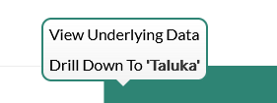
Dashboard
Progress Milestone

Slide 28
Dashboard
Work Status – “New” Schemes
Work Status – “Retro” Schemes

Slide 29
MS Project
Work in Progress Schemes

Slide 30
Sample Site Visit Photos

Slide 31
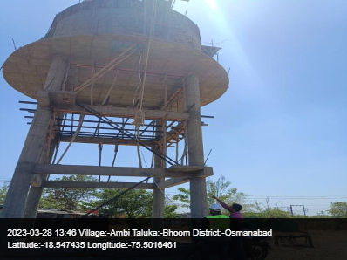
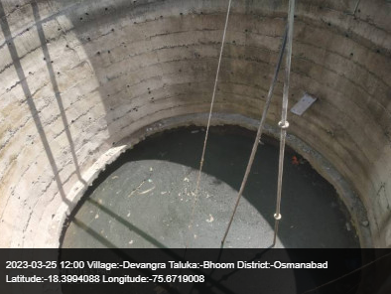
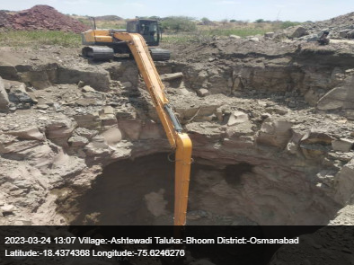
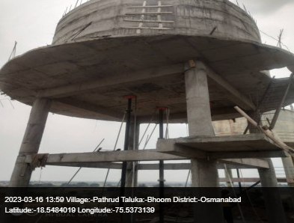
Bhoom Taluka

Slide 32
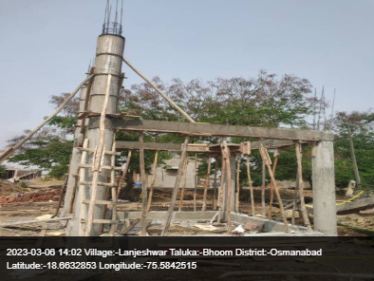
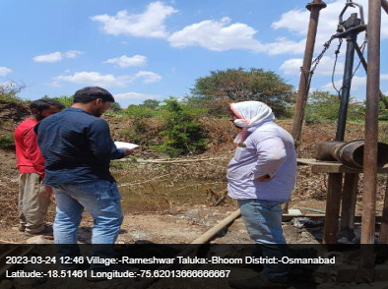
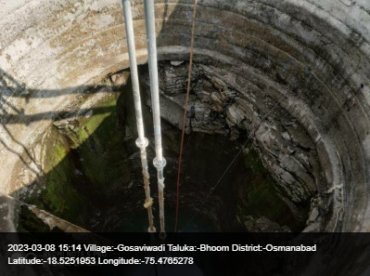
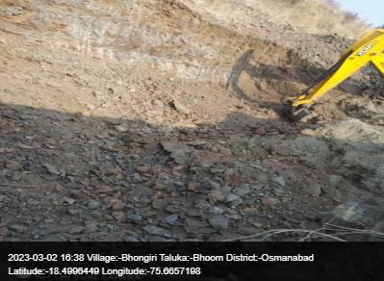
Bhoom Taluka

Slide 33
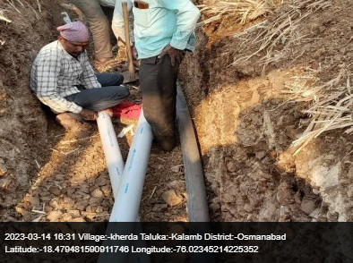
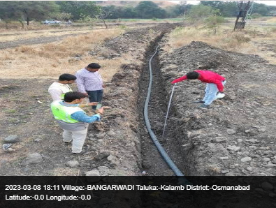
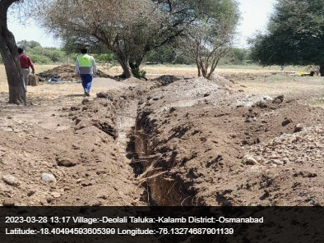
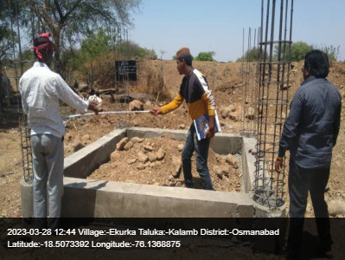
Kalamb Taluka

Slide 34
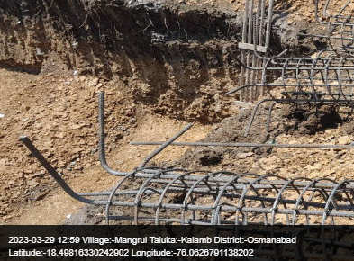
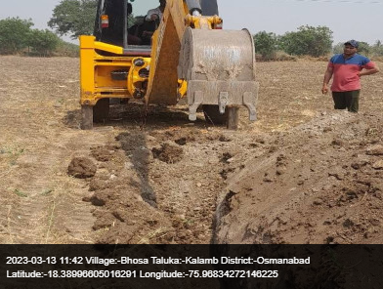
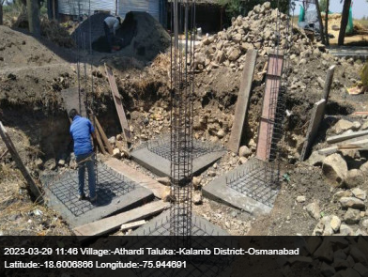
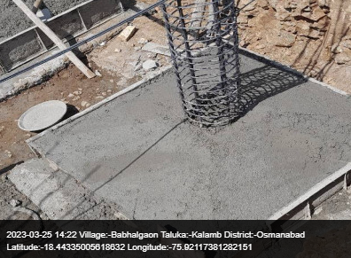
Kalamb Taluka

Slide 35
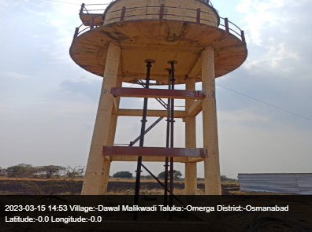
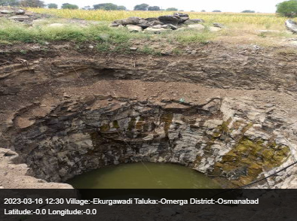
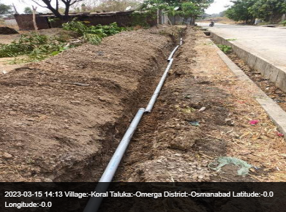
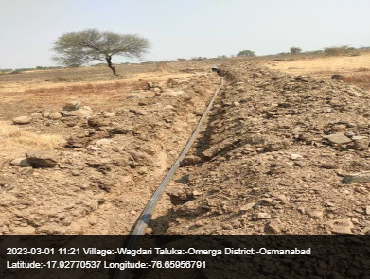
Omerga Taluka

Slide 36
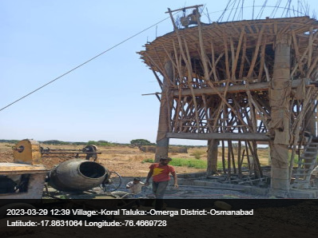
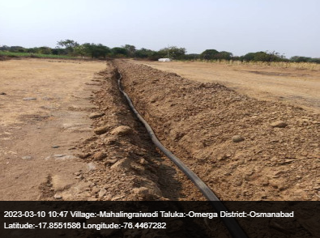
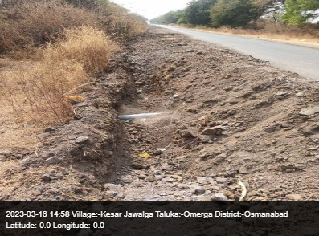
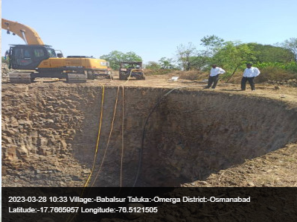
Omerga Taluka

Slide 37
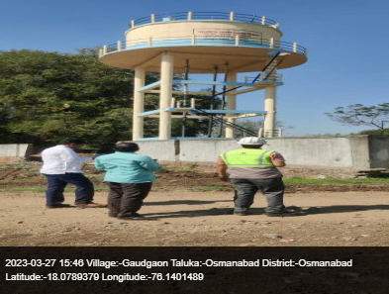
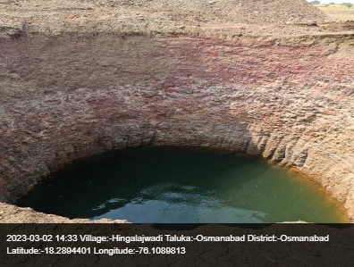
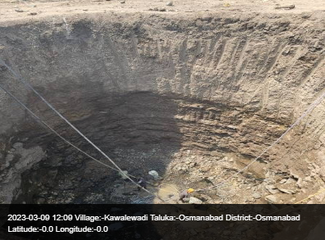
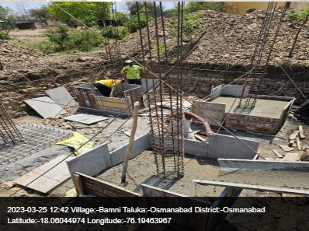
Osmanabad Taluka

Slide 38
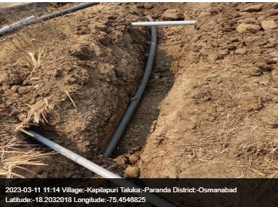
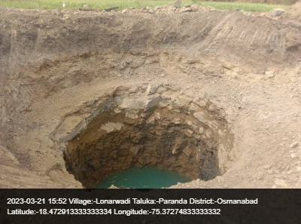
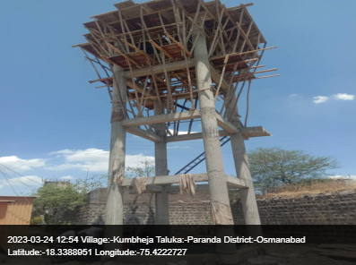
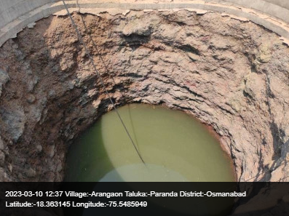
Paranda Taluka

Slide 39
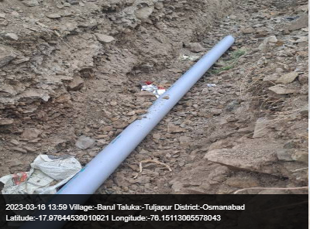
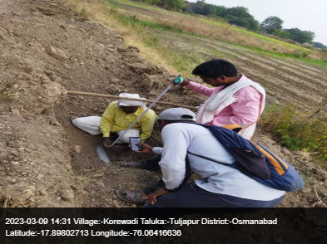
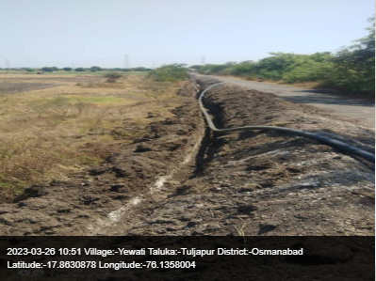
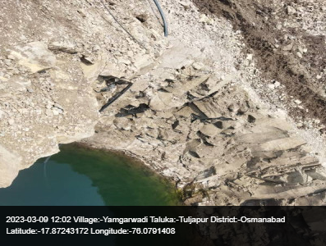
Tuljapur Taluka

Slide 40
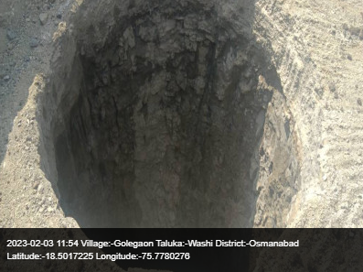
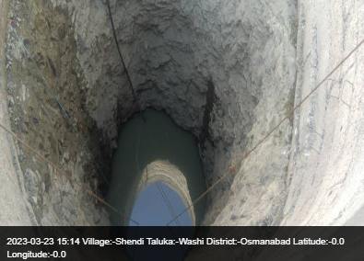
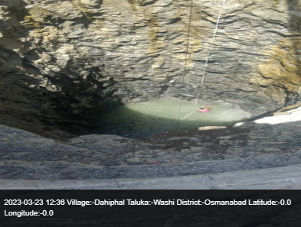
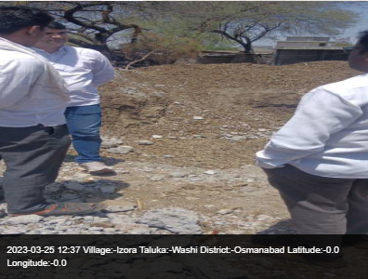
Paranda Taluka

Slide 41

Thank You!

